Slide 1
CAPSTONE PROJECT
POWER SYSTEM FAULT DETECTION AND CLASSIFICATION
Presented By:
1. Tarun Kumar - R.D. Engineering College - AI/ML

Slide 2
OUTLINE
Problem Statement
Proposed Solution
System Development Approach
Algorithm & Deployment
Result (Output Images)
Conclusion
Future Scope
References (GitHub link)
IBM Certifications

Slide 3
PROBLEM STATEMENT
Design a machine learning model to detect and classify different types of faults in a power distribution system. Using electrical measurement data (e.g., voltage and current phasors), the model should be able to distinguish between normal operating conditions and various fault conditions (such as line-to-ground, line-to- line, or three-phase faults). The objective is to enable rapid and accurate fault identification, which is crucial for maintaining power grid stability and reliability.

Slide 4
PROPOSED SOLUTION
To address the challenge of identifying and classifying faults in a power distribution system, we developed a machine learning-based solution following a structured approach.
Data Collection:
Used a Kaggle dataset containing labeled power system fault data.
Features include voltage, current, and phasor measurements across various conditions.
Data Preprocessing:
Cleaned and normalized raw data to ensure consistency.
Selected relevant features to improve model accuracy and reduce noise.
Machine Learning Algorithm:
Implemented a Random Forest Classifier for multi-class fault classification.
Performed training and hyperparameter tuning to enhance performance.
Deployment:
Deployed the model using IBM Watson Machine Learning.
Integrated with a web-based interface for real-time fault prediction.
Evaluation:
Evaluated model performance using accuracy and confusion matrix.
Achieved reliable classification across multiple fault categories.

Slide 5
SYSTEM DEVELOPMENT APPROACH
To build a reliable and scalable fault detection system, we followed a structured development pipeline that ensures seamless integration of data processing, machine learning, and deployment components. The approach is lightweight yet effective, making it suitable for cloud-based environments like IBM Watson Studio.
System Requirements:
Cloud Platform - IBM Watson Studio (Lite Plan)
Environment - Jupyter Notebook with Python 3.x runtime
Libraries Required to Build the Model:
Pandas, NumPy – for data manipulation and preprocessing (Used automatically by the service)
Scikit-learn – for model training and evaluation (Random Forest Classifier)

Slide 6
ALGORITHM & DEPLOYMENT
Machine Learning Algorithm:
I implemented a Random Forest Classifier, a robust ensemble learning method that builds multiple decision trees and merges their outputs for accurate and stable predictions. It handles multi-class classification effectively, making it ideal for identifying various power system faults.
Key steps include:
Training on labeled voltage and current data.
Tuning hyperparameters to improve model accuracy and prevent overfitting.
Deployment:
The trained model was deployed on IBM Watson Machine Learning, enabling real-time prediction via a cloud interface. Deployment was done through Watson Studio using an online deployment setup, providing a scalable and accessible API endpoint.
Key deployment features:
User interface for test input and visualization of predictions.
Prediction output includes fault label and confidence score.

Slide 7
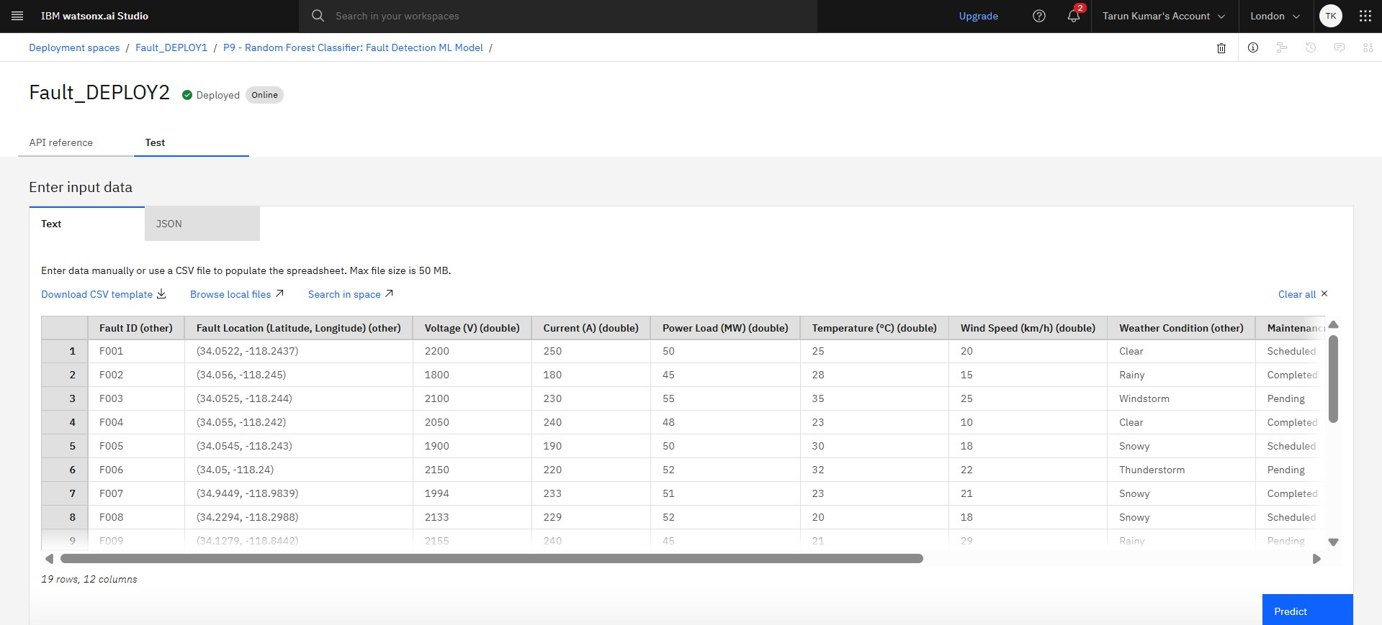
RESULT
TEST DATA INSERTION

Slide 8
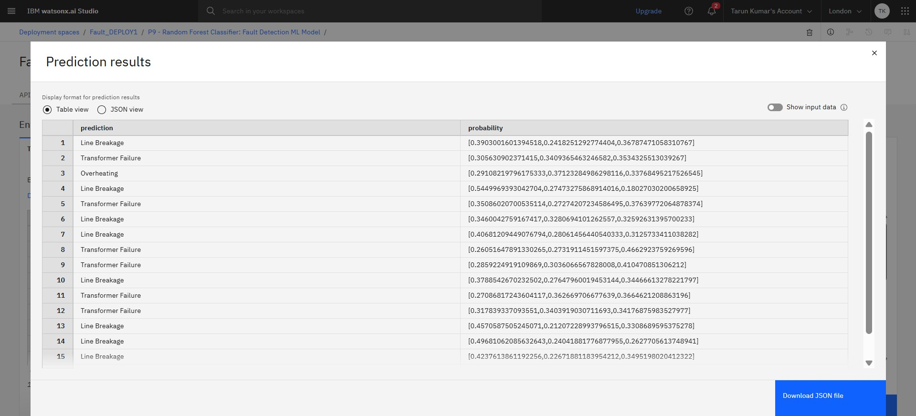
RESULT
TEST DATA RESULT

Slide 9
CONCLUSION
This project successfully demonstrates the application of machine learning in detecting and classifying power system faults. By leveraging historical electrical data and deploying the model using IBM Watson Studio, we created an efficient and scalable solution capable of identifying faults with high accuracy.
The system contributes to smarter grid monitoring by enabling:
Faster fault detection
Reduced downtime and maintenance costs
Improved reliability of power distribution systems
This approach can be extended and integrated into real-time monitoring systems for industrial-
scale deployment.

Slide 10
FUTURE SCOPE
The current model provides a solid foundation for automated power fault detection. Future improvements can enhance its performance, scalability, and real-world integration.
Real-Time Data Integration
Integrate live data streams from IoT sensors and smart meters for real-time fault detection and faster response.
Model Optimization and Expansion
Explore advanced algorithms like deep learning or ensemble stacking to improve accuracy. Expand the model to classify more fault types and handle complex grid scenarios.

Slide 11
REFERENCES
Power System Faults Dataset – Kaggle
https://www.kaggle.com/datasets/ziya07/power-system-faults-dataset
IBM Watson Studio Documentation:
https://www.ibm.com/cloud/watson-studio
Scikit-learn: Machine Learning in Python:
https://scikit-learn.org/
GitHub Repository Link:
https://github.com/codetarun/Power-System-Fault-Detection-and-Classification

Slide 12
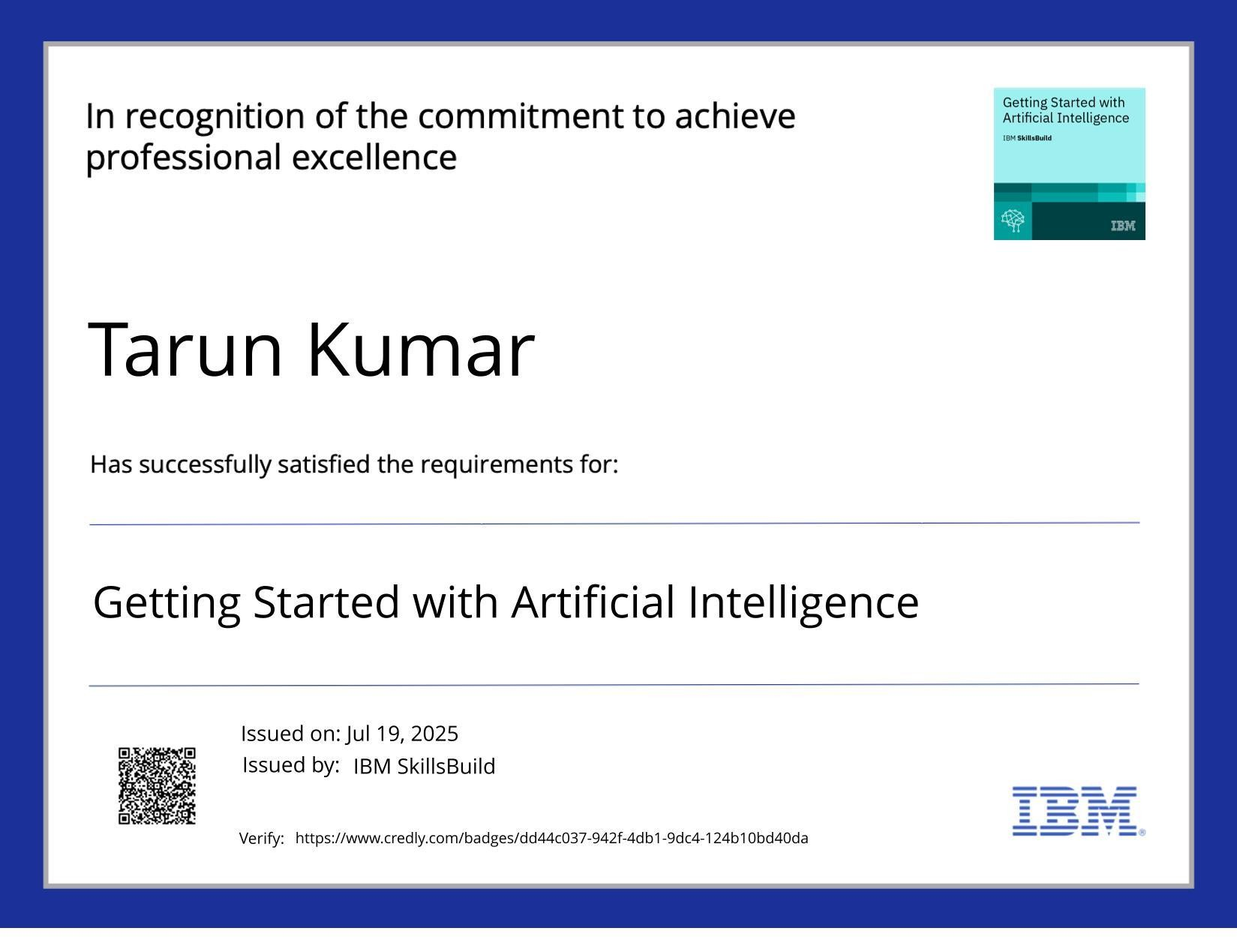
IBM CERTIFICATIONS

Slide 13
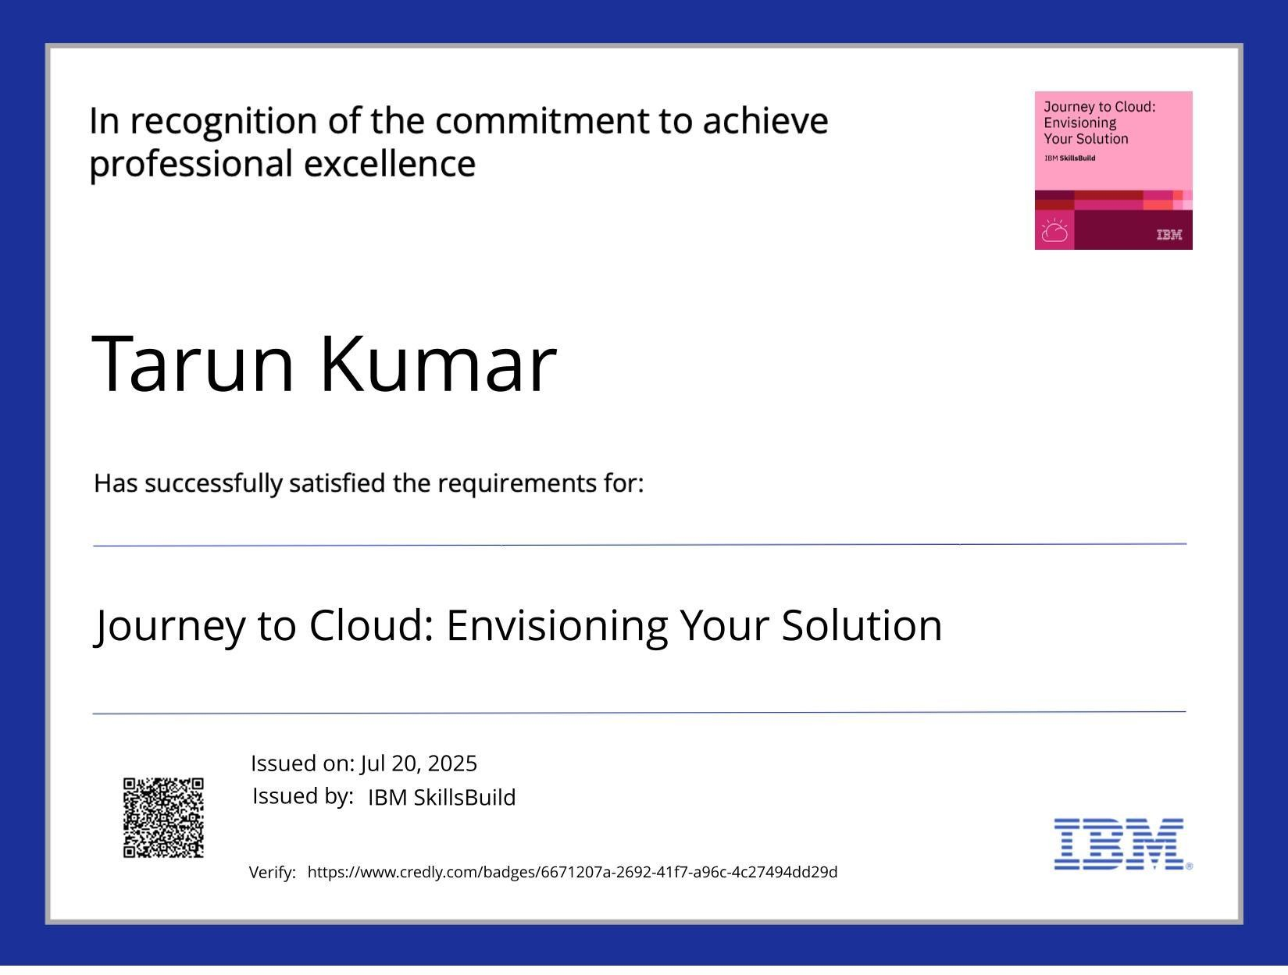
IBM CERTIFICATIONS

Slide 14
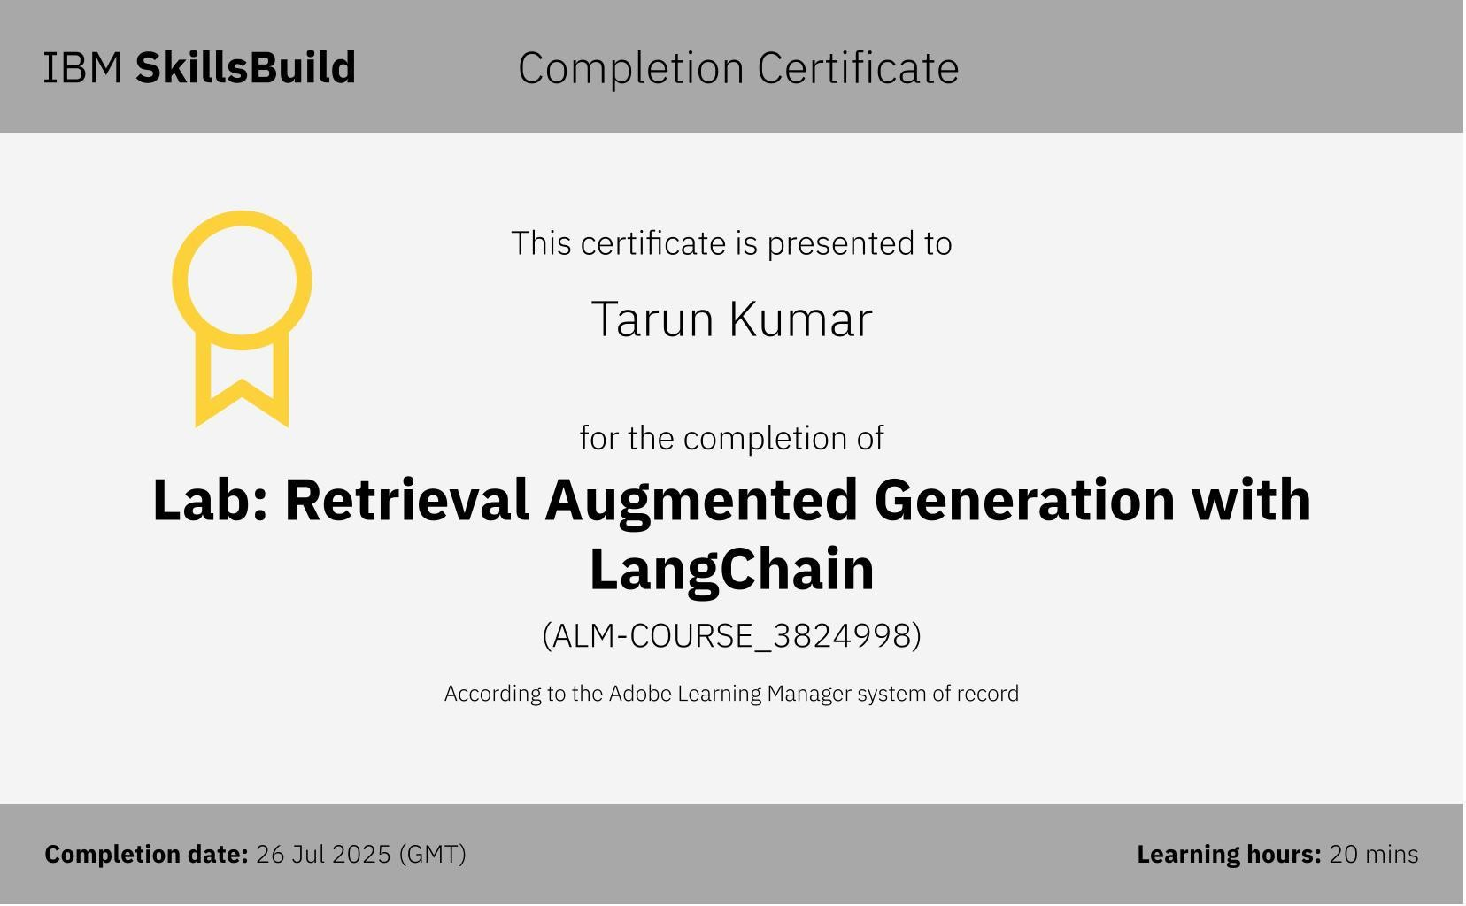
IBM CERTIFICATIONS

Slide 15
THANK YOU

